Slide 1

Blockchain and It’s Applications
^{Blockchain Fundamentals} Created by 101blockchains.com

Slide 2
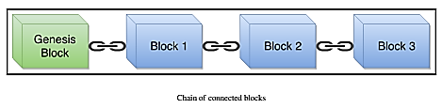
Blockchain
Non-Technically.

Slide 3
Blockchain Basics
Module 1
^{Blockchain Fundamentals} Created by 101blockchains.com

Slide 4
History and Evolution of Money
Visible money exists today is $40 Trillion
Invisible money is more than $1300 Trillion
15000BC people lived in tribes
only aim pray and survive
No pray daily, started Bartering system (Exchange of things)
Bartering system started in Mesopotamiam tribes now Iraq
People started trading

Slide 5
History of Cryptocurrency
Problem raised with increase in population
Started writing on clay, Introduction of accounting
Problem with barter system is that if you don’t need one thing than why exchange?
2500BC commodity money was introduced like cow, alcohol, goat, swords, knife, tobacco and even human (Slaves)
In yap Island people used heavy stones
weight was about 5 ton called Rai stones
They remembered the ownership

Slide 6
History of Cryptocurrency
Problem with commodity money is the worth of that?
can reduce the worth like alcohol expired
600BC metallic money in Ancient Greece (The Lydian Stater) → The first coin
After Lydian Stater, every empire introduced their coin and started trading
difficult to carry large amount of coins
got stolen and counting problem

Slide 7
History of Cryptocurrency
The era of paper money started in Mongolian china by emperor Kubla Khan, the grandson of Genghis Khan
Introduced paper money
Those who refused to trade with paper money were killed
This paper money was called IOU (I owe you)
People thought why not use this for trading?
Introduced banking system

Slide 8
History of Cryptocurrency
People started exchange the gold with IOUs issued by people (Bank)
IOU was issued in large amount and started inflation
People contacted banks for their gold again not enough gold against that IOU
stopped trading against IOU
1816 Britain brought a law
Paper money against gold standard
Raised an issue of deflation
1933 President of America Franklin D. Roosevelt ended the relationship between gold and money

Slide 9
History of Cryptocurrency
Banks started publishing money like previous
Relationship of money and gold is ended so money is just a piece of paper (FIAT money)
1980 E-Money was introduced to be transmitted immediately
The problem with digital money is hacking which is difficult but not impossible
In 2009 Bitcoin was introduced which is cryptocurrency and is unable to get theft

Slide 10
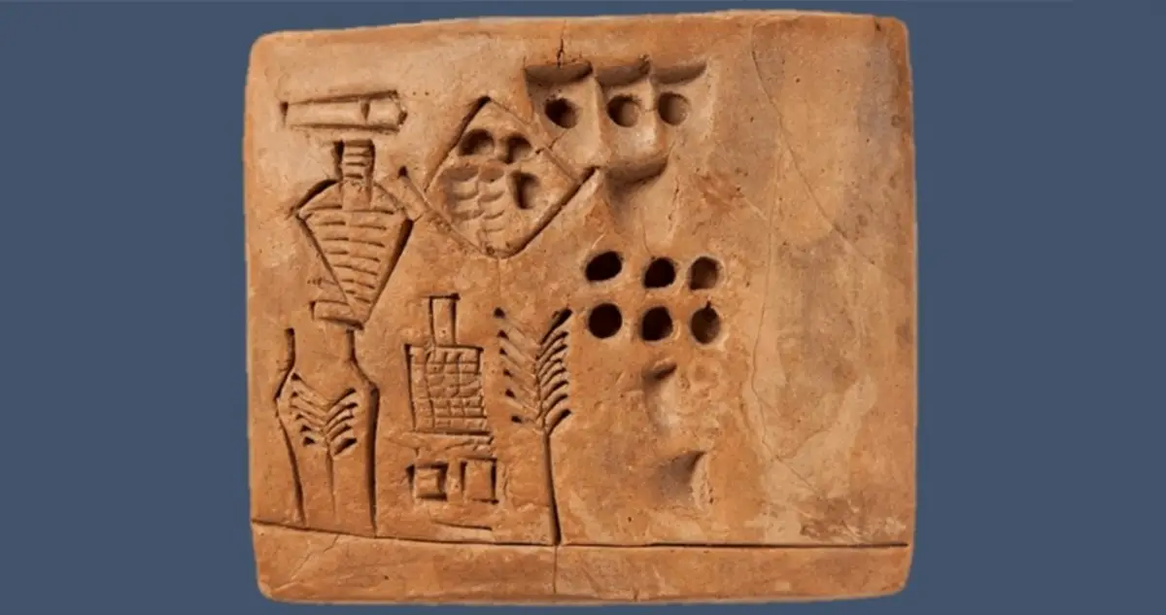

Slide 11


Slide 12


Slide 13


Slide 14
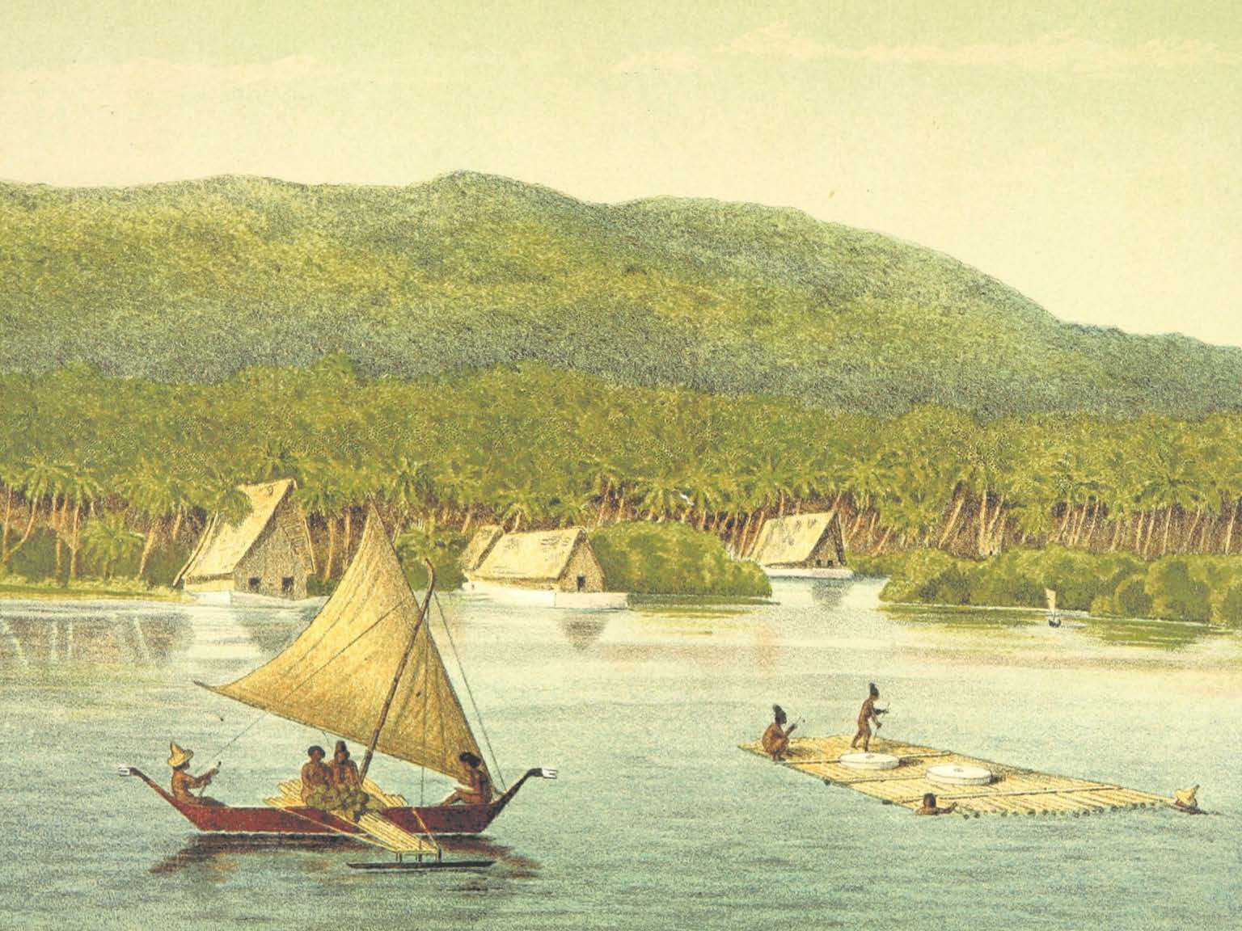

Slide 15
